Slide 1

SPEAKER CHANGE DETECTON
TEAM:
JAYAPRADEEPKUMAR P (125015056)/IT
RAMANATHAN K (125003249)/CSE
GUIDE:
SHANKAR SRIRAM V S

Slide 2
TABLE OF CONTENTS
01
02
03
05
04
06
Objective&Motivation
Base Paper
Problem Statement
Modules&
Dataset
Literature Survey
Proposed Techniques
07
Conclusion

Slide 3
Motivation
Traditional speaker change detection models struggle with maintaining accuracy across languages due to linguistic variations.
Vocal features along with textual interpretations can be generated for a given audio effectively. these features combined alongside meta features can provide a hybrid solution
Our motivation lies in addressing this gap by developing a speaker change detection model specifically tailored for multilingual settings.

Slide 4
Objective
Develop a deep learning-based framework for extracting language-agnostic features from audio recordings.
compute the time intervals of any speech utterance to a clustered-label of speaker identity
find a hybrid solution that combines speech and text analysis were developed for the SCD problem.
Incorporate language-specific adaptations to improve performance for individual languages while maintaining overall multilingual capability.

Slide 5
BASE PAPER
Or Haim Anidjar, Yannick Estève, Chen Hajaj, Amit Dvir, Itshak Lapidot, ”Speech and multilingual natural language framework for speaker change detection and diarization”, Expert Systems with Applications(2023) 119238
Link

Slide 6
Problem Statement
Existing speaker change detection models lack robustness in multilingual environments, hindering their ability to accurately identify speaker boundaries across different languages and dialects.

Slide 7
Modules
01:Data processing
->Text Encoding
02:Feature Selection
->Voice Encoding
Language Agnostic-BERT
MLM
TLM
Speaker turn detection
Genaralized E2E
03:Classification Alg.
->Speaker Clustering
04:Ensemble techniques
:Speaker Diarization
Agglomerative Hierarchical Clustering (AHC)
bagging
boosting

Slide 8
Dataset
70+hours
12,263
The ICSI Meeting Corpus is audio dataset with meeting recordings
Segmented over 75 recordings with each of avg 56 min
Of unique words in total ,available in SPH & WAV formats
53
Different speakers with 3-10 participants in each audio

Slide 9
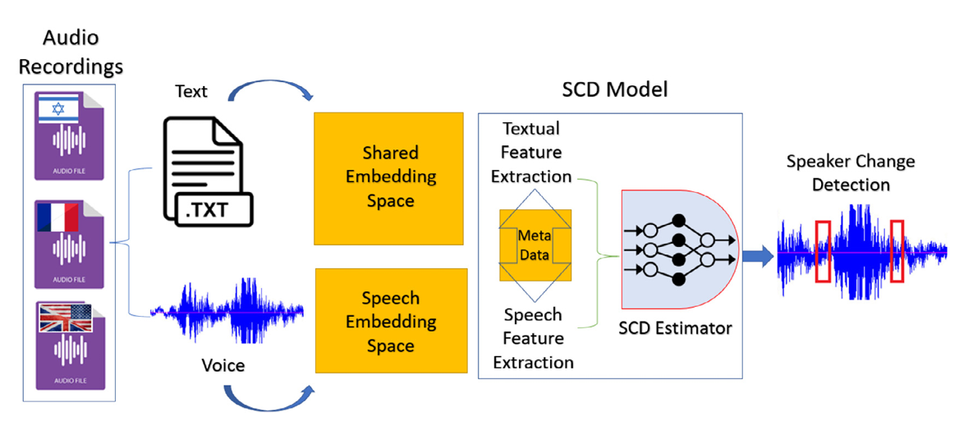

Proposed Techniques

Slide 10
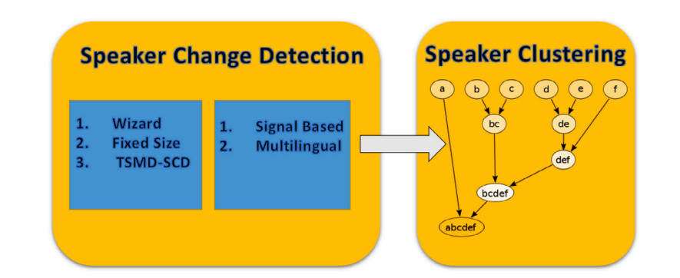
Proposed Techniques

Slide 11
Voice embedding

Slide 12
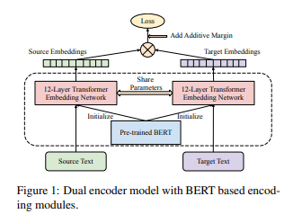
Text Encoding
LABSE
Unsupervised learning
adopts bert methods for a hybrid bert model
language agnostic

Slide 13
Sliding window method
An SCD component over a test-file audio-recording returns all the
locations on which a speaker-turn has been detected. Thus,in order to
feed a clustering algorithm
BERT is pre-trained on large corpora of text using unsupervised learning objectives such as masked language modeling and transformer language modelling
Finally, the input layer size of the neural network used for the SCD component model is 2062: for the text component 1536 features, another 512 for the speech signal, and the last 14 for the meta-data

Slide 14
Literature Survey
Title | Author | Year | JAN
Multimodal speaker segmentation and diarization using lexical and acoustic cues via sequence to sequence neural networks. | Park and Gregorie | 2018 | SCD and SD problem
Language-agnostic bert sentence embedding | Fen et al. | 2020 | Text Encoding method language agnostic BERT
Generalized end-to-end loss for speaker verification. | Wan et al. | 2018 | Video Encoding Method
Hybrid speech and text analysis methods for speaker change detection. | Anidjar, O. H., Lapidot, I., Hajaj, C., Dvir, A., & Gilad, I. | 2021 | Neural network architechture
Identifying spatiotemporal clusters by means of agglomerative hierarchical clustering and Bayesian regression analysis with spatiotemporally varying coefficients | Jaya, I. G. N. M., & Folmer, H. | 2020 | Agglomerative Hierarchical Clustering
Hybrid speech and text analysis methods for speaker change detection. | Hybrid speech and text analysis methods for speaker change detection. | 2021 | Wizard-based SCD, fixed-size SCD, and the SCD model

Slide 15
Conclusion
In this study, we showcased the effectiveness of integrating textual information and speech analysis to create a hybrid model for Speaker Change Detection (SCD) within a Speaker Diarization (SD) system.
benefits of exploiting textual information and speech analysisresulting in a notable enhancement of Diarization Error Rate (DER).
Our approach demonstrated resilience to high Word Error Rates (WER) and revealed the complementary nature of speech, text, and meta-data modalities, leading to cumulative improvements in the SD system's performance.
in a closed set of languages, there is a gap when a removal or supplement of one
(or more) language to the model is needed

Slide 16
References
Park, T. J., & Georgiou, P. G. (2018). Multimodal speaker segmentation and diarization
using lexical and acoustic cues via sequence to sequence neural networks. In
INTERSPEECH
Feng, F., Yang, Y., Cer, D., Arivazhagan, N., & Wang, W. (2020). Language-agnostic
bert sentence embedding.
Wan, L., Wang, Q., Papir, A., & Moreno, I. L. (2018). Generalized end-to-end loss for
speaker verification. In ICASSP (pp. 4879–4883).
Anidjar, O. H., Lapidot, I., Hajaj, C., & Dvir, A. (2021). A thousand words are worth
more than one recording: Word-embedding based speaker change detection. In Proc.
interspeech 2021 (pp. 3121–3125).
Anidjar, O. H., Lapidot, I., Hajaj, C., Dvir, A., & Gilad, I. (2021). Hybrid speech and text
analysis methods for speaker change detection. IEEE/ACM Transactions on Audio,
Speech, and Language Processing, 29, 2324–2338.

